Slide 1
Say No to Bullying
A Classroom Presentation
from the Members of
the G-House
of representatives
Notes:
Good morning/afternoon. I am _______, (and I am _______). We are members of the G-House of Representatives and are here today to talk to you about a very important issue.
If you look at this slide (point to it) can you tell me what the important issue is? (allow answer) Yes, it’s bullying, and it can be a real problem in a school.
Raise your hand if you have ever been bullied or known someone who has been bullied. (Look around and see how many hands are up.) Bullying is a real issue, isn’t it?

Slide 2
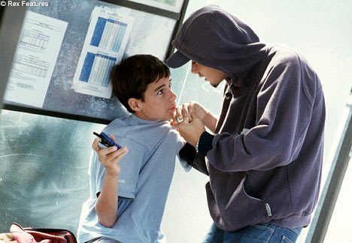
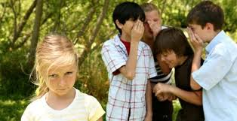
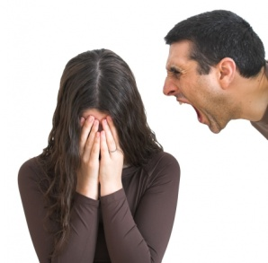
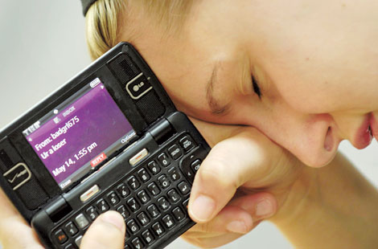
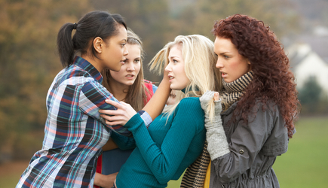
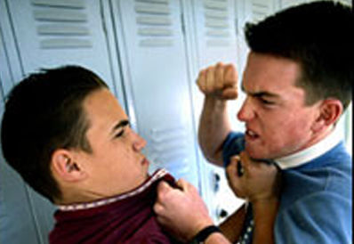
What is bullying?
Notes:
Let’s begin by finding out what you know already. What is bullying?
(Allow for 3-4 responses. Don’t comment much on the responses. Then move on to the next slide.)

Slide 3
What is bullying?
Bullying is a deliberate, repeated attempt to intimidate, embarrass,
or harm another person,
either with words or
physical actions.
Notes:
Here is a good definition for bullying. Please read it with me. “Bullying is a deliberate, repeated attempt to intimidate, embarrass, or harm another person, either with words or physical actions.”
Let’s look at a couple key words in this definition.
What does “deliberate” mean? (Allow for a couple answers, then say…) Deliberate means that you do it on purpose. You plan it and think about it ahead of time.
The other word we want to look at is “repeated.” What does that mean?
(Allow for a couple answers, then say…) Repeated means you do it over and over again.
Some other key words are “Intimidate” which means to scare and threaten someone. “Embarrass” means to make someone look bad in front of others. “Harm” means to hurt someone, either in their physical body or in their feelings.

Slide 4
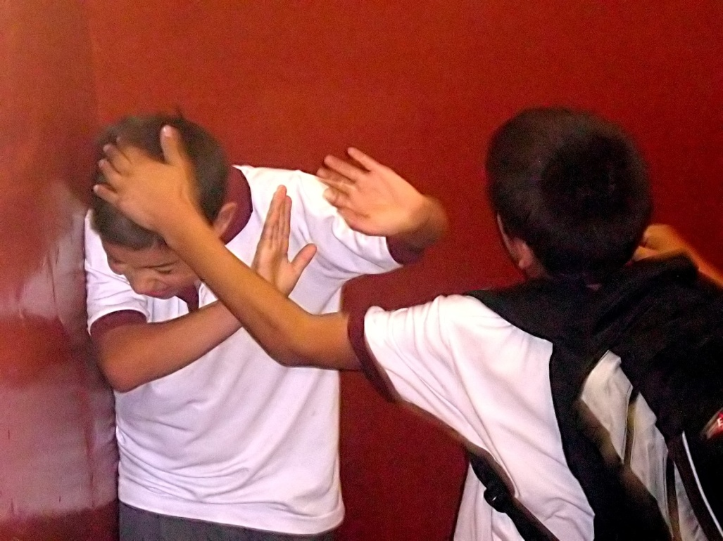
What is bullying?
For BOYS,
it’s more
physical.
Notes:
With boys, bullying tends to be more physical. Hitting, slapping, poking, punching, pushing, kicking…things like that.
Boys can also say bad things to others and bully people that way, but they mainly do their bullying in physical ways.

Slide 5
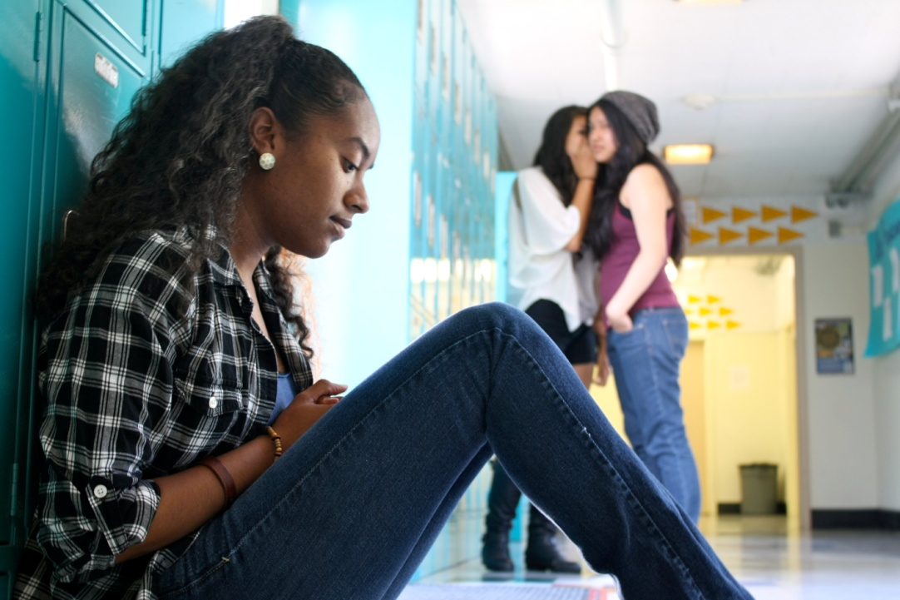
What is bullying?
For GIRLS,
it’s more
verbal/social.
Notes:
With girls, bullying is usually more verbal and social. Girls can sometimes be physical, just like the boys, but most of the time girls will bully others with words or with relationships.
Girls will tease, name-call, and gossip. They will try to hurt the person’s feelings or embarrass them. They will also try to get others to turn against the person they are bullying. They will try to make the person they are bullying look bad.

Slide 6

Who is involved in bullying?
Notes:
Next, let’s look at the people involved in bullying. Who are they? (Allow for some answers, but don’t comment so much. Then go to next slide).

Slide 7
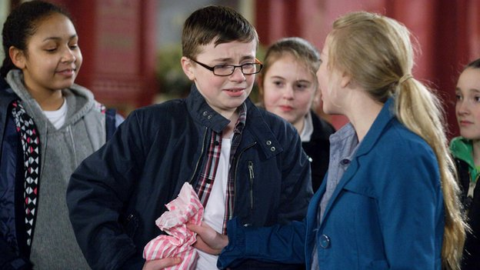
Who is involved in bullying?
Bullies
Targets
Witnesses
Notes:
In bullying, there are three groups involved.
The bully him or herself.
The target, or the person being bullied.
And the witnesses. Those standing by and watching.
Look at the picture.
Who looks like they are the bully? (blonde girl)
Who is the target? (The boy with glasses)
Who are the witnesses? (The people standing in back)
So really, almost everyone is involved in bullying. So that means everyone should be involved in stopping it.

Slide 8

Why is bullying bad?
Notes:
So, what’s the big deal? Why are we getting so worked up? Why is bullying bad? What would you say? (Allow for just a couple answers, but then move to next slide).

Slide 9

Why is bullying bad?
It causes fear, anxiousness, stress.
It affects school performance
and attitude.
It can make a person physically ill.
It can lead to depression, even
suicide.
Notes:
Bullying is very serious. For the target, the person being bullied, it can lead them to have (point to first bullet) fear, anxiousness, and stress.
(Point to second bullet) It can affect school performance and attitude about school. A bullied student’s grades could go down and they may not want to come to school anymore.
(Point to third bullet). Many times, the bullied person becomes physically ill. They get sick to their stomach, get headaches, and feel just awful.
(Point to fourth bullet). Sometimes, bullying even leads to the target getting depressed or worse, taking their own life. Sometimes--and you may have heard about these situations in the news--a bullied person gets so upset that they take other people’s lives, they kill the people who have bullied them, before they kill themselves.
There have been several school shootings in the news over the past few years because of bullying. How horrible!

Slide 10

Why don’t people stand up to bullying?
Notes:
Well if bullying is so bad, why don’t people stand up to bullying? Why do you think more people don’t stand up to bullying? (Allow for a few answers and then move to next slide.)

Slide 11
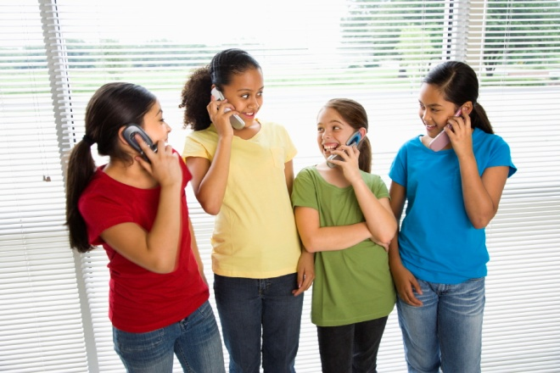
Why don’t people stand up to bullying?
They fear retaliation (pay back).
They don’t want to be
called a “snitch.”
They desire to be popular.
Notes:
Kids do not stand up to bullying because they are afraid of retaliation or pay back. They fear if they stand up to the bully, the bully will come after them.
Also, people don’t want to be called a snitch, or a tattle tale.
Finally, everyone wants to be liked and have friends. Sometimes, kids want to be popular and if the bully and his or her followers are the popular people, you may want to be accepted by them, so you go along, even though you don’t feel so good about it.

Slide 12

Where does bullying thrive?
Notes:
Where does bullying thrive, or to put it another way, where does bullying usually take place? (Go to next slide).

Slide 13

Where does bullying thrive?
Unsupervised places
Internet (cyber-bullying)
Violent video games and TV
Abusive homes
Notes:
Bullying happens the most in places that are unsupervised, where no adults or authority-figures are around. Bullying is a “behind the back” kind of thing. Why do you think that is? (Allow for some answers. Get out of the kids that because bullying is sinful, like many other sins, it’s done in secret.)
Because bullying is a “hidden” kind of thing, the Internet has become a place where a lot of bullying goes on. It’s called cyber-bullying. Because no one is watching you when you are on-line, kids feel they can say whatever they want.
Violent video games and TV shows make bullying look cool and fun.
And sadly, some kids homes are very abusive and harsh, with their parents being very angry and hurtful to them. This can lead these kids to become abusive and harsh to others.

Slide 14

How can bullying be stopped?
Notes:
Of course, the most important question is this one. Please read it with me. (Go to next slide)

Slide 15
How can bullying be stopped?
Understand that bullying is the
problem, not you!
You are not weak, “soft” or a baby if
you don’t like being bullied.
Understand the bully (hurt, unloved,
lonely, insecure, unpopular).
Notes:
Stopping bullying begins with the kids who are being bullied.
First, if you are being bullied you need to understand that bullying is the problem, not you. Sometimes the bullied person can feel bad or responsible, but it is not their fault.
Second, the bullied kid, the target, needs to know that they are not weak or soft if they don’t like being bullied. Bullying is wrong and should not be tolerated.
Third,--and this can be hard--we have to understand the bully. Many times a bully is a person who has been hurt themselves. They may feel unloved, lonely, insecure, or unpopular themselves. As hard as it can be, we need to love them and try to help them. That’s how Jesus treats us when we sin.

Slide 16
How can bullying be stopped?
Pray about it (for you and the bully).
Tell the bully to stop it, and walk away.
Tell a trusted adult what you feel.
Report the bullying to a school official.
Notes:
How can bullying be stopped? It can be stopped if we all do some simple things. Let’s read together the statements on this slide:
Pray about it (for you and the bully).
Tell the bully to stop it, and walk away.
Tell a trusted adult what you feel.
Report the bullying to a school official.

Slide 17

What are good ways to handle bullying ?
Notes:
What are good ways to handle bullying? In addition to the previous ideas, there are some other good ways to handle bullying. (Go to next slide)

Slide 18

What are good ways to handle bullying ?
Pray about it.
Avoid the bully.
Stay in bigger groups.
Get active in school.
Laugh along.
Ignore and walk away.
Change the subject.
Give the bully “permission.”
Do not fight back.
Notes:
Let’s read together the statements on this slide, and then we’ll give you some examples: (Read statements first, then go back and cover examples)
Pray about it. God can help. We need to ask for his help.
Avoid the bully. If you stay away from the bully, he/she can’t get to you.
Stay in bigger groups. Because bullying is done more in secret, staying in
groups will help prevent the bully from getting to you.
Get active in school. When you are active in school, you have more power. A bully is not going to come after a strong, focused kid. They pick on the weaker kids. Just like a lion in the jungle usually goes after the sick and weak animals to eat.
Laugh along. If the bully is laughing about something in you, just laugh along with them. For example, if they laugh at you and say, “You’re ugly!” Laugh along and say something like, “I know. I can’t even look at myself in the mirror.”
Ignore and walk away.
Change the subject. If the bully says something like, “Your breath stinks” change the subject by saying something like, “Who do you want to win the Superbowl?”
Give the bully “permission.” Say to the bully, that’s OK, you can be mean to me if you want. I don’t care.
Do not fight back. While you should defend yourself if you are genuinely being physically hurt, it is best to not fight back. If you do, the bully feels he/she can hurt you more then.

Slide 19
Do you have any questions?
Notes:
Allow for some questions if there is time.

Slide 20
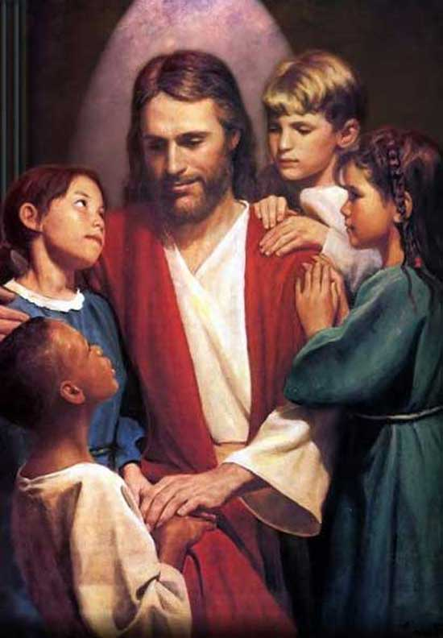
Let’s eliminate all bullying at GHLS!
Let me give you a new command:
Love one another.
In the same way I loved you,
you love one another.
This is how everyone will know
that you are my disciples—
when they see the love
you have for each other.
John 13:34-35 The Message
Notes:
Let’s eliminate bullying at ______________. And let’s follow the words of this Bible passage from John 13. It is from the Message translation. Let’s read it together:
Let me give you a new command:
Love one another.
In the same way I loved you,
you love one another.
This is how everyone will know
that you are my disciples—
when they see the love
you have for each other.
Thanks for letting us talk to you today about this important subject.
Let’s stop all bullying at __________ and other places we go.

